Slide 1
Group Project: Milestone 01
Team: SIP

Slide 2
PUBS database
The "Pubs" database typically consists of several tables related to a fictional publishing company. Below are some of the common tables you might find in the "Pubs" database:
Authors: This table typically contains information about authors
Titles: This table holds details about the various books or publications
Publishers: Information about the publishing companies
Employee: Contains details about employees working for the publishing company
Sales: Records of sales transactions
Royalties: Information about royalty payments to authors based on book sales
TitleAuthor: This is often a junction table that establishes many-to-many relationships between authors and titles
Stores: Information about bookstores or retail locations where books are sold
Discounts: Records of discounts applied to book sales

Slide 3
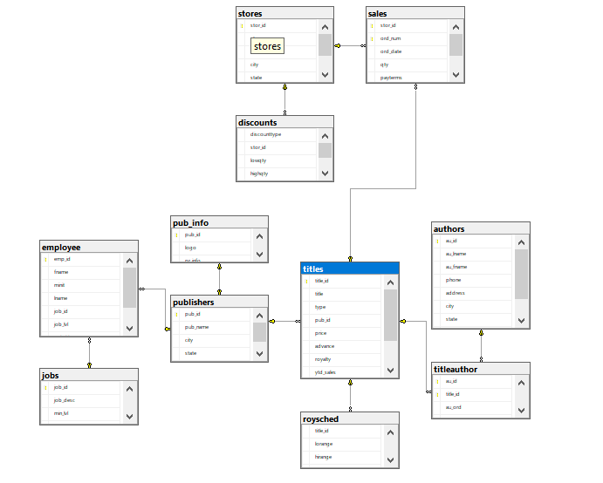
Entity Relationship Diagram

Slide 4
Business Processes
Sales reporting: For each publication, we want to identify sales metrics such as total quantity and revenue by authors, stores and time dimensionality. Purpose is to determine what kind of books sell better.
Author royalty: For each author, we want to determine how much royalty has been paid by publishers. Purpose is to find out which authors are more costly to collaborate with.
Store sales: For each store, we want to provide monthly sales snapshot. Purpose is to define which stores are profitable at what season or month.

Slide 5
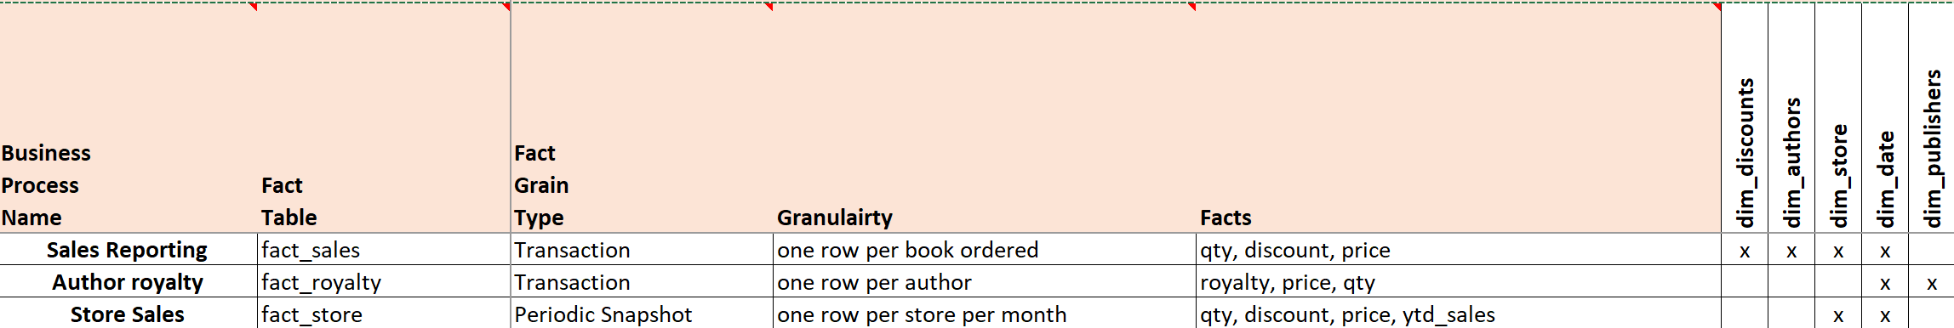
Bus Matrix

Slide 6
Challenges
Insufficient data
Absence of metadata

Slide 7
Next steps
Dimensional modeling: build dimension and fact table template
Data Warehouse implementation

